Slide 1
Prototyping

Slide 2
Objectives of Lecture
What is prototyping
Aims of prototyping
Prototyping techniques
Prototyping tools

Slide 3
What is Prototyping?
Essential element in user centred design
Is an experimental and partial design
Involves users in testing design ideas
Typically done very early in the design process
Can be used throughout the SDLC

Slide 4
What is a prototype?
In terms of User Interaction/ User Experience design it can be (among other things):
  a series of screen sketches
  a storyboard, i.e. a cartoon-like series of scenes
  a Powerpoint slide show
  a video simulating the use of a system
  a cardboard mock-up
  a piece of software with limited functionality written in the target language or in another language

Slide 5
Why Prototype?
Traditional software development: you can’t test until you implement
Traditionally users lack the ability to envisage designs conceptually and their may be a conceptual mismatch between the designer and the user
Users are often unable to comment on technical design documents
Users often lack the ability to imagine the ramifications of design decisions
Implementation is expensive, and there is nothing to test until you have made that expenditure of effort and schedule time

Slide 6
Why Prototype?
Result: any design errors are built in to the first thing you can test, and it is very expensive to make changes
Result: design errors (unless they are really bad), are left in the product
A prototype provides users with a concrete representation of the proposed design

Slide 7
Breaking this implementation paradox
Build a prototype of the basic functionality, especially the interface
Test the prototype, which will uncover design errors
Correct the errors
Repeat until you have a clean design
A major tool for improving usability
Heavily used in industry

Slide 8
Why Prototype?
The aim of prototyping is to resolve uncertainty about
    functional and user requirements
    operation sequences
    user support needs
    required representations
    “Look and Feel” of the interface
    appropriateness of the design

Slide 9
What to prototype?
Different types of prototyping are appropriate for different stages of design
  Product conceptualization – requirements – task match user acceptance
  Product Design
  Product development
  Product testing and Deployment
Work flow, task design
Screen layouts and information display
Difficult, controversial, critical areas

Slide 10
General Features of Prototyping
Enables the designer to quickly build or create examples of :-
    The data entry form
    The menu structure and order
    The dialogue styles
    Error messages
Inexpensive to develop – intention is to discard/modify it
Should not require programming skills

Slide 11
Types of prototyping
Low-fidelity Prototyping
High-fidelity Prototyping

Slide 12
Low-fidelity Prototyping
Uses a medium which is unlike the final medium, e.g. paper, cardboard
These have no functionality but still are useful for:-
  Generating ideas
  Gaining insights into what the user might want or is thinking Eg: a paper based design of a data entry screen
Is quick, cheap and easily changed
Examples:
sketches of screens, task sequences, etc
‘Post-it’ notes
storyboards

Slide 13
Storyboards
  Using “film-scripting” techniques to visualize interactions between users and the system
Often used with scenarios, bringing more detail, and a chance to role play
It is a series of sketches showing how a user might progress through a task using the device
Used early in design

Slide 14
Sketching
Sketching is important to low-fidelity prototyping
Don’t be inhibited about drawing ability. Practice simple symbols

Slide 15
Using index cards
  Index cards (3 X 5 inches)
  Each card represents one screen
  Often used in website development

Slide 16
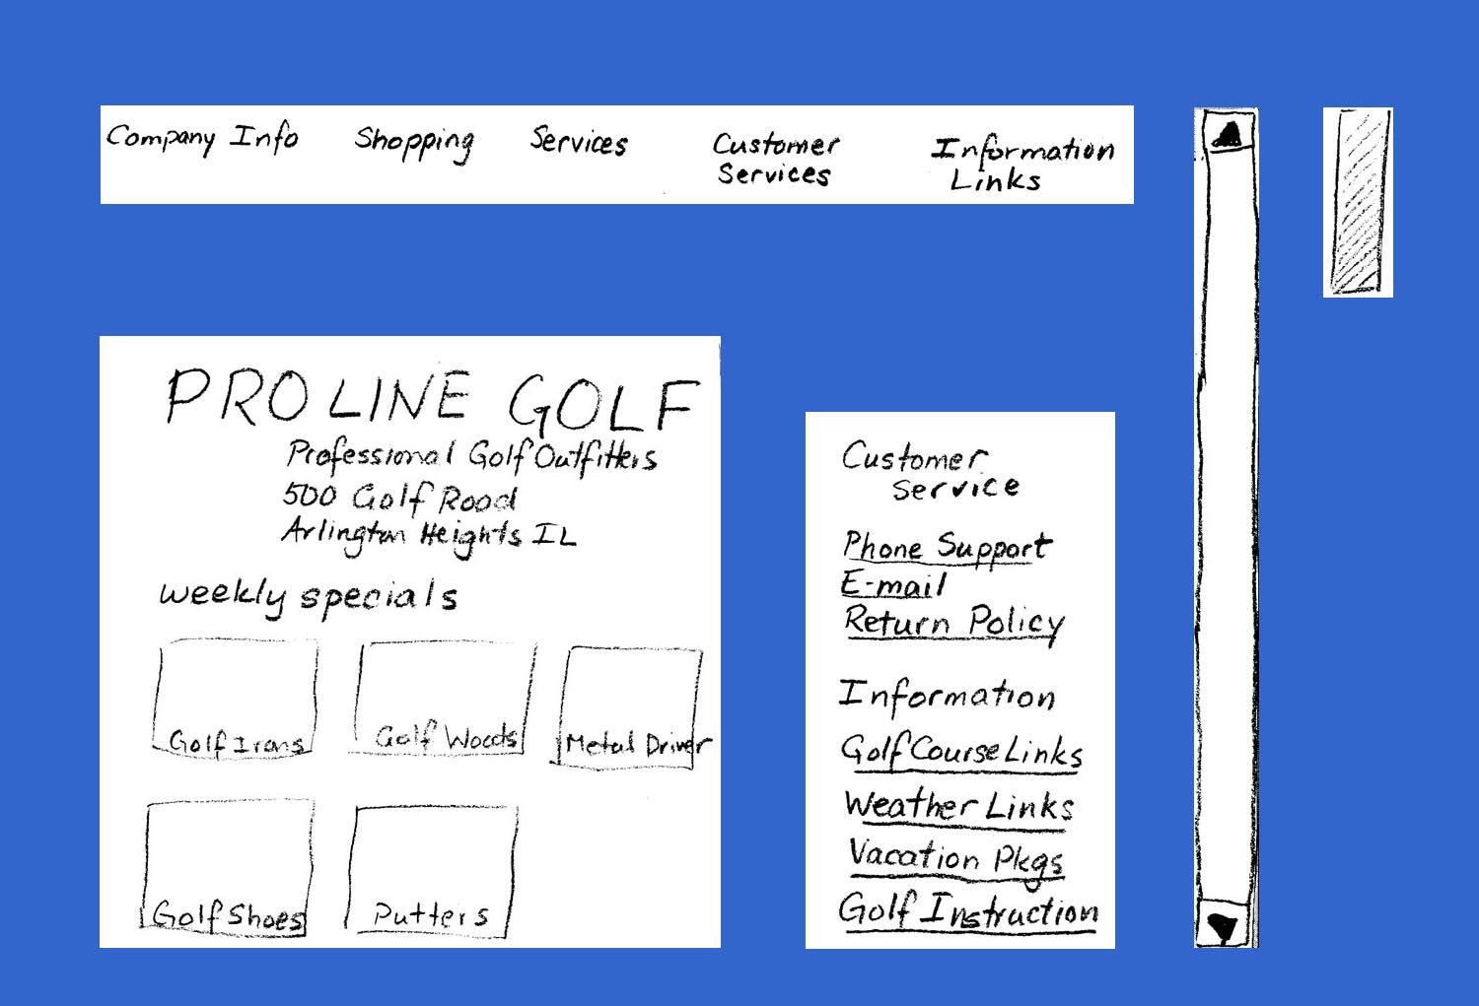
Elements of a paper prototype
Menu Bar
Scroll
Bar
Opening Contents
Secondary Menu

Slide 17
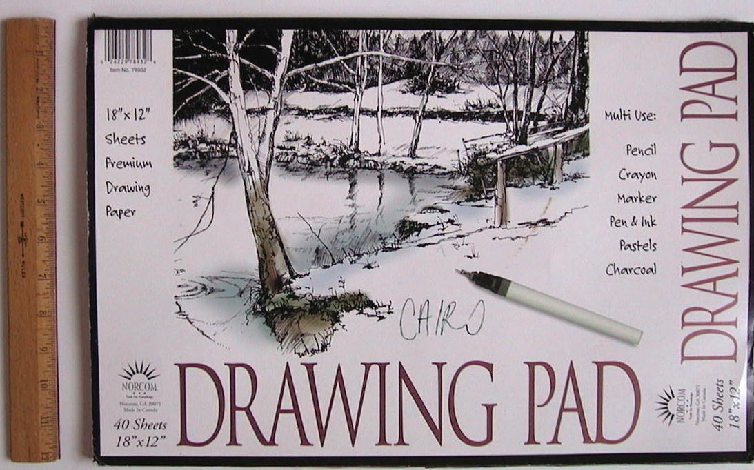
Some examples from Mc Crackens Students!!

Slide 18
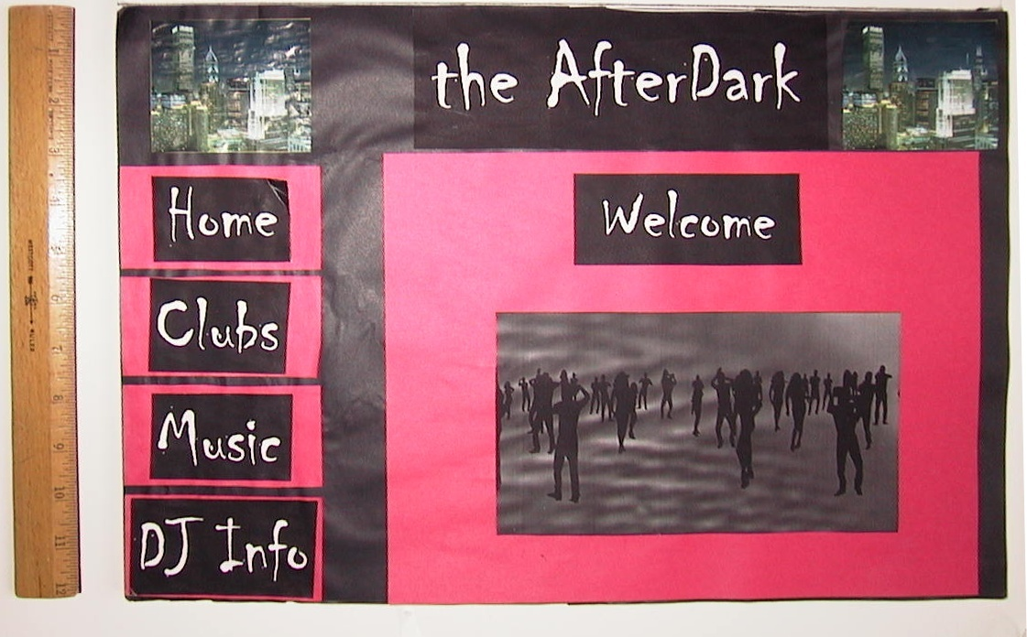
Their home page
Notes:
I put in the ruler only to show the scale, of course.

Slide 19
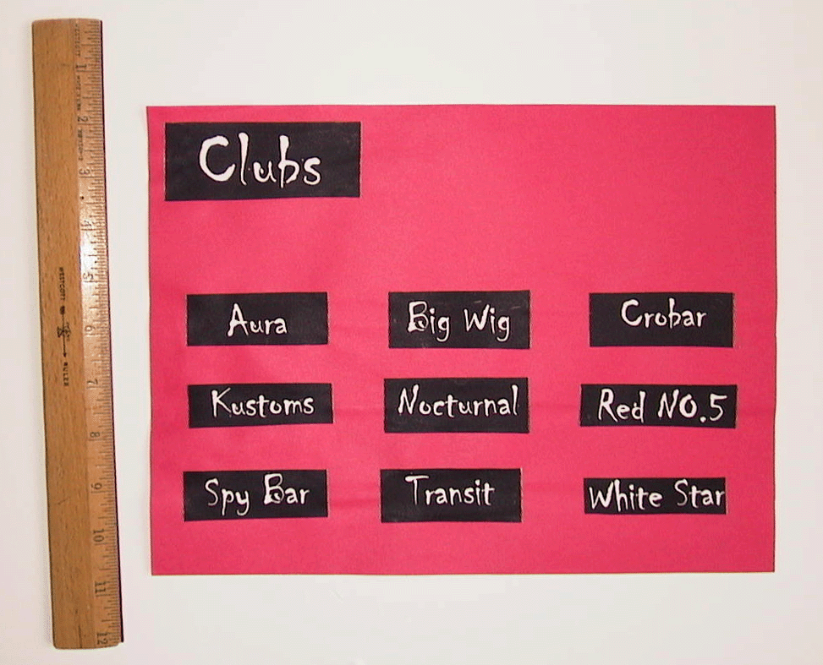
User “clicks on” (points to) Clubs button

Slide 20
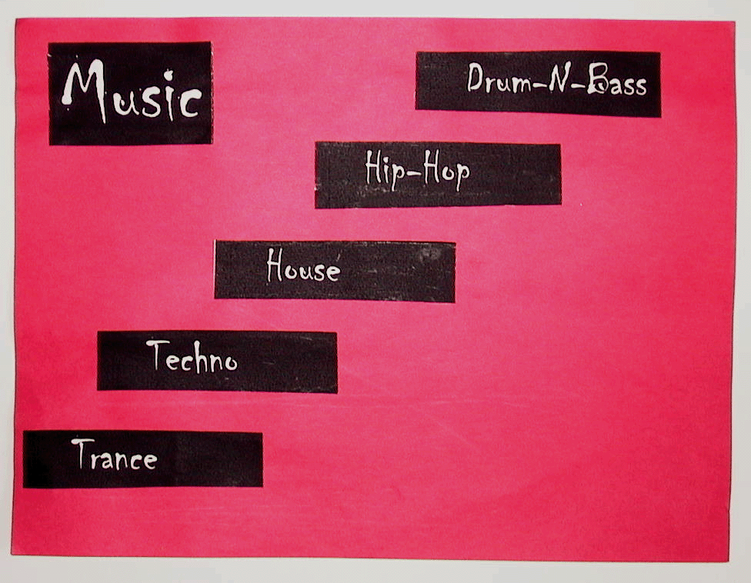
The Music page

Slide 21
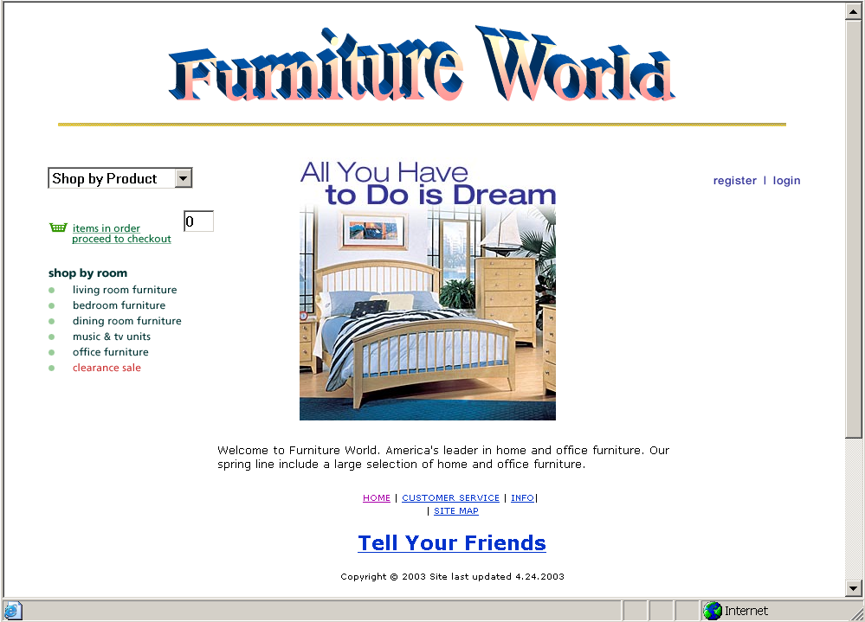
After prototyping and user testing, this is what their home page looked like
Notes:
The intended message: prototyping pays off, in sites that work. And look good. All ten teams did work at this level. I can’t believe how hard they worked, and how effective the results were. If I had demanded this kind of effort there would have been delegations to the dean: “We’re being asked to do six hours work for three credits!” As it was, they simply got caught up in the excitement of doing good projects, and poured on the effort. Seeing early prototypes fostered just a bit of competition, which never hurts. (If not overdone.)
And it was a total delight to hear, in their presentations, what they learned in prototyping and in user testing. Validated the course, in their own words. Courses should always go so well.

Slide 22
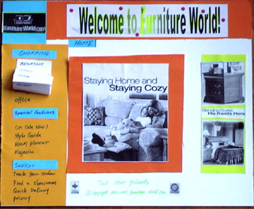
The home page
Pulldown menu
Notes:
This is a paper prototype, but the students used the computer to create a few elements of it. What looks like glare in the title graphic is actually their choice of a kind of gradient effect.

Slide 23
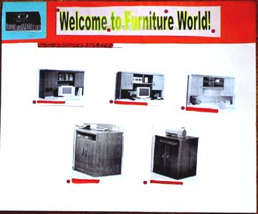
A second-level page

Slide 24
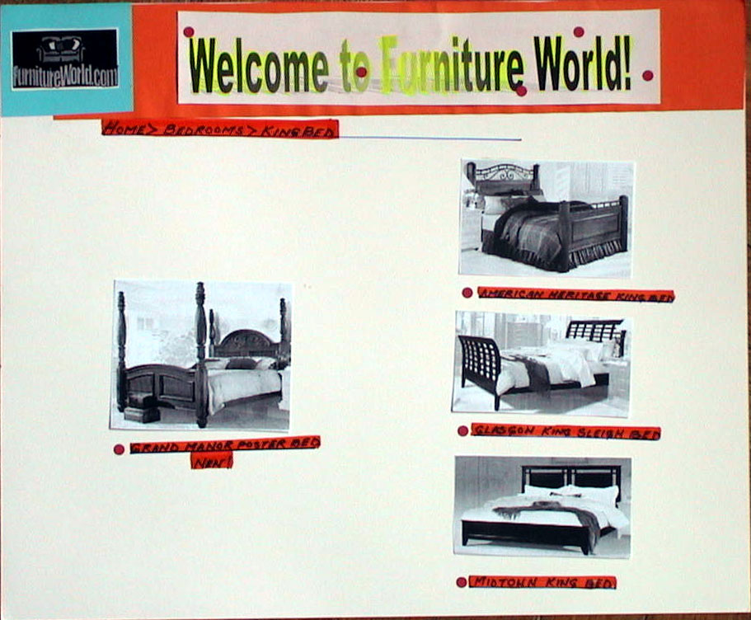
Another second-level page

Slide 25
High-fidelity prototyping
  Uses materials that you would expect to be in the final product.
  Prototype looks more like the final system than a low-fidelity version.
  For a high-fidelity software prototype common environments include Macromedia Director, Visual Basic, and Smalltalk.
  Danger that users think they have a full system…….see compromises

Slide 26
Prototyping Techniques
The three major kinds of prototyping are
  “Throw away” prototyping (a.k.a. “rapid prototyping”)
  Incremental prototyping
  Evolutionary prototyping (a.k.a “Rapid Application Development, RAD)

Slide 27
Throw-away (Rapid) Prototyping
    Used exclusively in requirements gathering
Aims to collect information on requirements and the adequacy of possible designs
Recognizes that requirements are likely to be inaccurate when first specified
The emphasis is on evaluating the design before discarding it

Slide 28
Throw-away (Rapid) Prototyping
Advantages
Helps the designer to evaluate the design very early in the the design cycle
It is good for addressing the problem of users not knowing or being unable to state their requirements
Provides the opportunity for continued evaluation and refinement of the design
Increases the chance of getting a well designed system acceptable to the users with the required functionality and ease of use

Slide 29
Throw-away (Rapid) Prototyping
Disadvantages
Can consume a lot of resources – users analysts programmers. Therefore can be costly as well as time consuming
The continued process of design evaluate redesign may mean that the design phase of the cycle is considerably increased
May be a long time before get a working system
Reluctance to ‘throw away’ or discard the prototype
Users expectations/wishes may be unrealistic
  May not be technically or economically feasible

Slide 30
Incremental Prototyping
    Not actually prototyping at all, but the delivery of prioritized functions incrementally to a single, overall design
There is one overall design for the system
It is partitioned into independent and smaller components
Final product is built as separate components one at a time and released as a series of products
  E.g.: General student details data module – the students assessment profile module

Slide 31
Incremental Prototyping – Advantages
Allows large systems to be installed in phases
Helps to avoid the delays between specification and implementation
Core system features are provided early
Users are not overwhelmed with a complex level of functionality in one go
Suitability and appropriateness of key requirements can be checked
Less essential features can be added later

Slide 32
Incremental Prototyping – Disadvantages
Need to have an overall view of requirements
Suitable development software must be used – not just high level prototyping software
Long development timescale before full functionality is obtained
This may be incompatible with management business goals
  Eg Need to get to market before a competitor
  Urgent requirements for a complete solution

Slide 33
Evolutionary prototyping – RAD
    As for incremental prototyping but with evolving design
Additions and amendments are made following evaluation and the system is regenerated in its amended form
In this case the prototype evolves into the final system

Slide 34
Evolutionary prototyping – Advantages
The system can cope with change during and after implementation
Again helps to overcome the gap between specification and implementation
Users get some functionality quickly

Slide 35
Evolutionary prototyping -Disadvantages
Can lead to a long development timescale
May have limited functionality which may not be apparent to the user
May believe that they have the final complete system and may therefore be unimpressed!

Slide 36
Other Prototyping Techniques
Full prototype
  full functionality, lower performance than production software
Horizontal prototype
  displays “breadth” of functionality, no lower level detail “back end” support Eg. Database link
Vertical prototype
  full functionality and performance of a “slice” or small part of the system

Slide 37
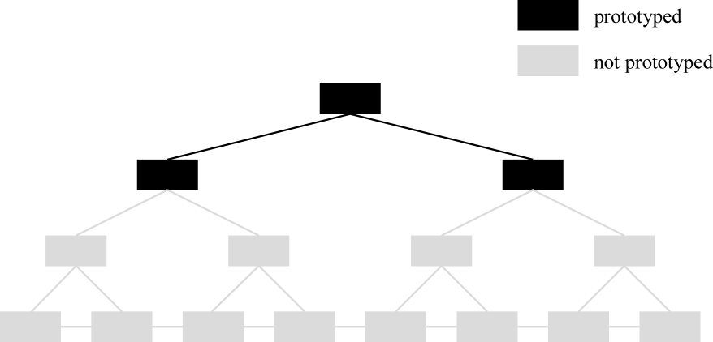
Horizontal prototype: broad but only top-level

Slide 38
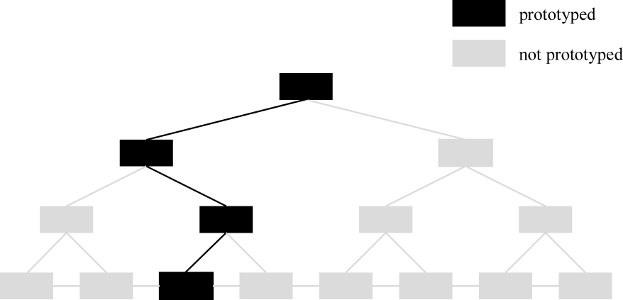
Vertical prototype: deep, but only some functions

Slide 39
Compromises in prototyping
All prototypes involve compromises
For software-based prototyping maybe there is a slow response? sketchy icons? limited functionality?
Two common types of compromise
    ‘horizontal’: provide a wide range of functions, but with little detail
    ‘vertical’: provide a lot of detail for only a few functions
Compromises in prototypes mustn’t be ignored. Product needs engineering

Slide 40
Prototyping Tools
Invision
UXpin
Proto.io
Mockplus
Just in Mind
Adobe Experience Design
Marvel
Origami Studio
Principle

Slide 41
Summary
Different kinds of prototyping are used for different purposes and at different stages
Prototypes answer questions, so prototype appropriately
Prototypes and scenarios are used throughout design
Evaluation of the prototype is essential

